Slide 1
Big Data Analytics - Airmech case study
- Su Yang

Slide 2
Goals
Predict the likelihood a player is going to leave the game.
Understand the behavioral reasons.
Make data-driven decisions/actions (what metrics give us insight for tracking players).
$$$$$

Slide 3
Scope of Data
Monetization data (27 columns, 6742683 rows)
In-game behavior data (53 columns, 49203678 rows)
2.8 billions data points… (therefore Big Data)

Slide 4
Scope of the Data
Reduced to: Level 3 or up (77% of all players); first 15 days.
Players who will stop playing one week later are labeled Leavers.
We train/cross-validate/test the algorithm on old gen data, and make predictions on new gen data.

Slide 5
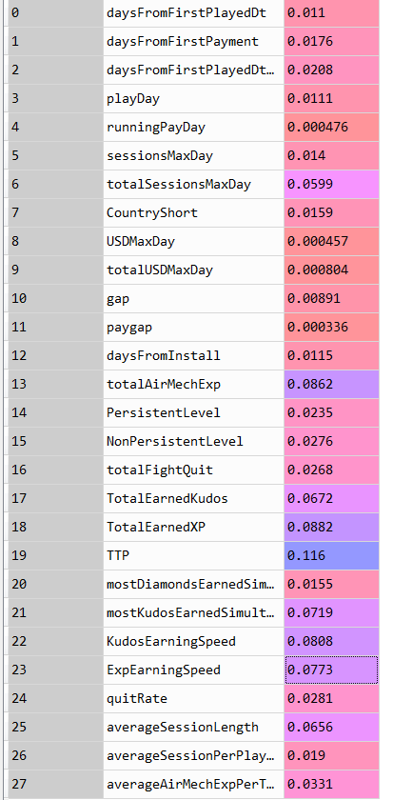
What metrics should we use?
Metrics Importance
Because using all 80 parameters of non-relevant parameters will overfit the model by creating noise.
This first step (trimming parameters) requires market intelligence (or expert) and an understanding of players’ behaviors.
Total Time Played has the most influence on the outcome

Slide 6


Model Validation (sort of)
44.8% are leavers on old gen, 46.1% are predicted to leave in one week on new gen, results are consistent.
F-score = 0.68 (industry benchmark = [0.5,0.7].) -> above average.

Slide 7
How to look at results:
Analysis
Insight
Proposal

Slide 8
Important metrics
Metrics Importance
Average Session Length and Total Sessions are good indicators of retention rate, (confirmed expectations).
Insight: Drops in those metrics show interest loss, providing opportunity to re-engage player before losing them.
Sessions-related decent indicators

Slide 9
Important metrics
Metrics Importance
Kudos and Exp earning speed are very strong interest indicators, and less expected.
Insight: Player plays faster = faster Kudos/Ex gain = more engaged to the game. Slowing down means they are less hooked. How can we change that?
3rd and 4th important indicators are speed-related

Slide 10
Important metrics
Metrics Importance
The Most Kudos Earned After A Game is a surprisingly key factor. (highest reward)
Insight: Anchoring and Optimism Bias (“casino symptom”). Higher reward peak will increase retention.
Proposal -> create a crazy Wednesday with random +5% to 20% reward during 6 hours?
5th Element

Slide 11
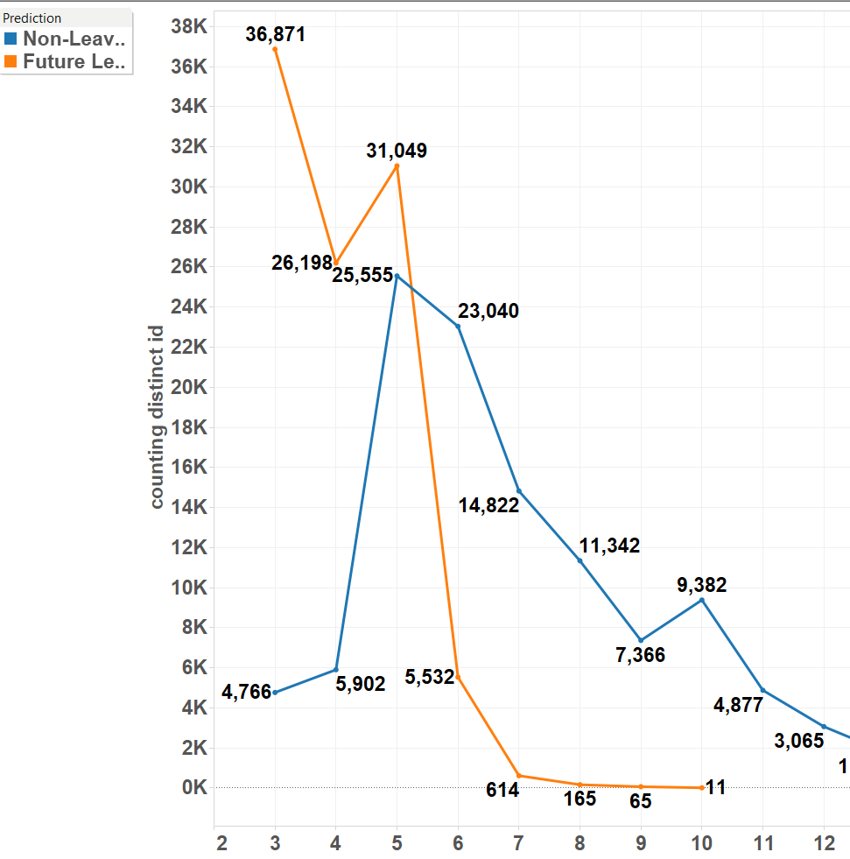
New achievement?
Pic on lv 3 (model bias) and lv5 for future leavers.
Insight: Need new achievement/ reward for better retention rate on lv 5.
Proposal: unlockable achievement at lv 5: “Gain exp/win game with a certain Airmech”

Slide 12
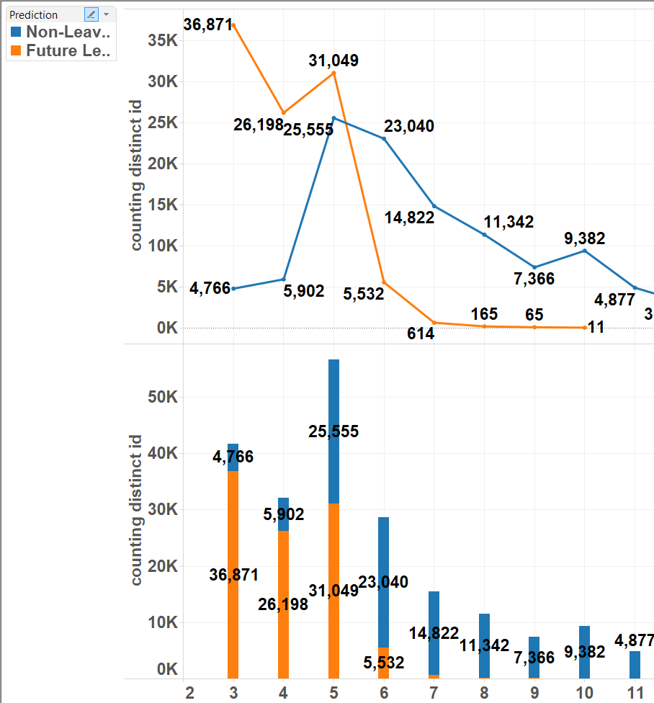
Level distribution
Leavers: 93.6% have lv 5 or less.
One more lv at lv 5: 45.1% -> 80.6% likelihood to keep playing.
Proposal: add “resolve” bar filling up along played games. Full bar gives +50% exp.

Slide 13
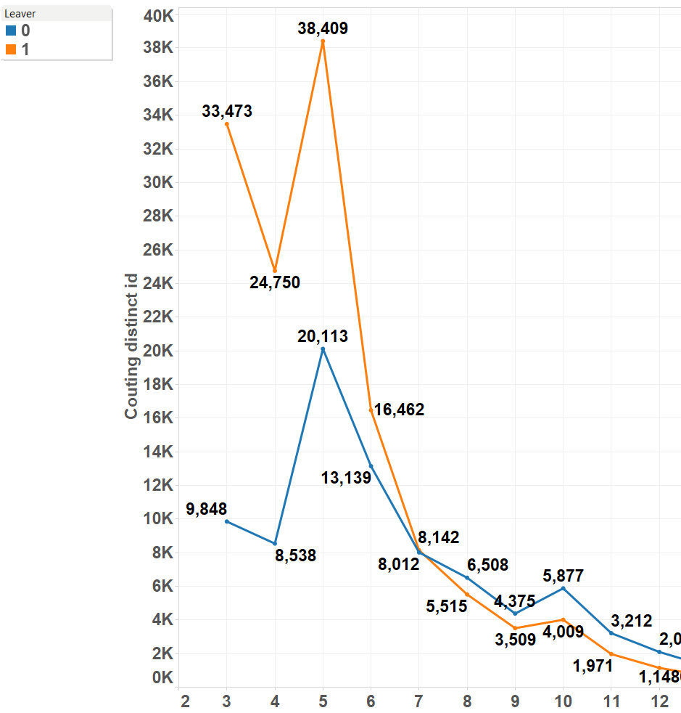
Level distribution (real)
“Real”
“Prediction”
Beware: the inactive period is 2 months, so the “real” data is biased towards leavers.

Slide 14
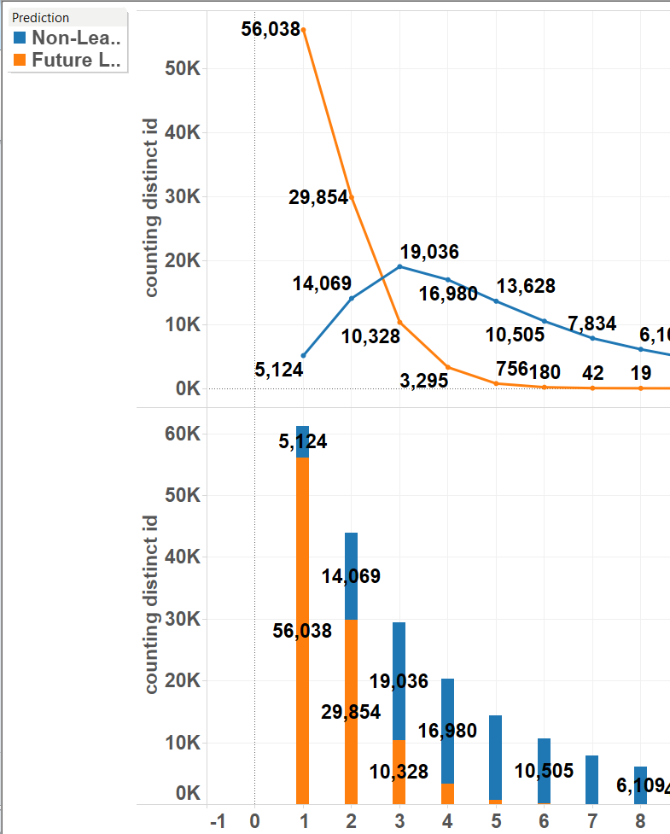
One more session?
Leavers curve is steeper than standard curve.
95.7% of leavers play 3 sessions or less (roughly 1 every 5 days). [install day]
One more session at 3 session: increase from 64.8% to 83.7% likelihood to keep playing.

Slide 15
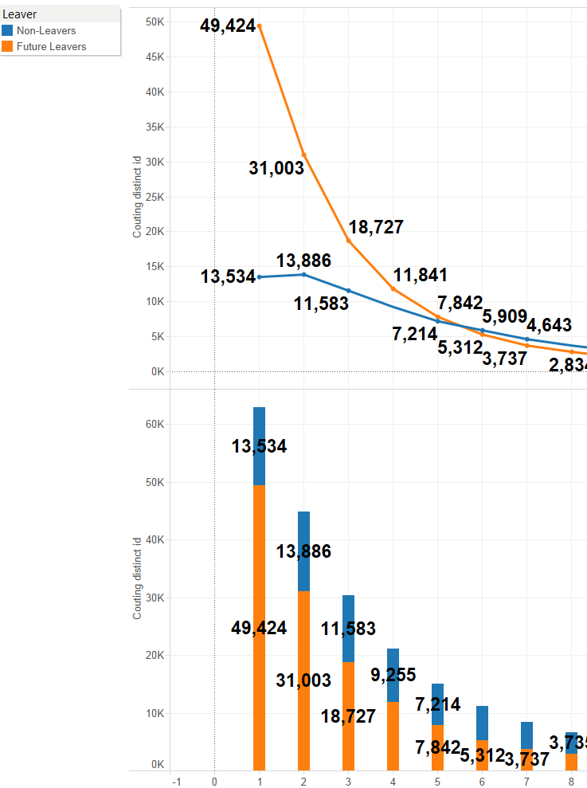
One more session? (real)
“Real”
“Prediction”
Beware: the inactive period is under 2 months, so the “real” data is biased towards leavers.
Proposal: The first victory every Xh (48?) gives double exp.

Slide 16
Conclusion
Big Data Analytics in video games:
Yes, it is all about Retention/Conversion.
(By understanding players’ behaviors better)

Slide 17
Appendix: Why Big Data in video games
Competitive gaming specifics:
Detect toxic behaviors -> community management. (more generally players clustering)
Bot detection. (Anomaly detection)
Matchmaking.
Game balance. (more generally data-driven design)
In-game economics.
More general:
Retention and monetization.
Information distribution (percolation, graphs or how to reach and have we reached the right audience. Sentiment analysis).
Content suggestion (By using collaborative filtering methods)

Slide 18
Appendix: Why Big Data in different industries
Today, 2.5 quintillion bytes of data is created every day, meaning 90% of the existing data in the world has been created in the last two years alone.
According to Mckinsey: Better Marketing analytics improve the returns on marketing by 10-20%, source.
In every sector: companies using Big Data generate 6% more profits and is 5% more competitive to their counterparts in the same business bracket.
Between 2010 and 20 12, the percentage of insurance companies that adopted/reported a competitive advantage by use of Big Data has surged from 35% to 74%, Source.
Ex: Twiddy & Company, a rental firm, cuts costs by 15 by comparing each contractor’s maintenance charges against the average of its 1200 other vendors etc…
Ex: Smartzip uses metadata on inhabitants of an area and predicts what house owners are the most likely to sell. And they are right at 80% of the time for a predictive period up to 3 months! This is what we call the “Target Data”.

Slide 19
Appendix: Types of problems Machine Learning can address
Binary problems: “Can I predict if a player is going to do X instead of Y?”. Ex: Is this player going to leave? Is this player going to monetize more than once? Is the player a toxic player?
Classification problems: “How many different type of object X do we have? What are the characteristics of the groups. Ex: Among the players likely to leave, what type of players do we have? How can we re-engage them according to their characteristics.
Suggestion problems: “The player has done X and Y and slowing down, what content Z can we suggest him that suits him the best?”. Ex: For Rainbow 6, my player has played a couple of specialists, what other specialist I can suggest him to play?
Anomaly detection: “ Is the player behaving normally?”. Ex: Is the player a Bot? Is the player account hacked?
Scoring (Regression) problems: “How score should we give to object X?” Ex: How much exp should I reward the player? What is the current elo of the player? What is the price of this in-game item if suggest to market fluctuations.

Slide 20
Appendix: Rational vs irrational
Rational problems: Phenomena involving rules.
Ex: Newton’s 2nd movement law.
Ex: How to win Breakout. (Cf Google DeepMind)
A F-score of 0.95 to 1 is expected. And the closer to 1 the better. Here algorithms with better predictions are well sought.
Irrational problems: Phenomena involving human decision-makings:
Ex: Is my player going to leave the game?
Ex: How much money the player is expected to spend on my game during its lifetime?
A F-score of 0.7 is expected. Lower than 0.51 is bad since it’s worse than randomness, higher than 0.9 is dubious and generally due to bias. Here the algorithms gives an interval of prediction and mostly used to understand better the variables which is a very important goal by itself.

Slide 21
Appendix: What our competitors do
Riot (mono-brand): Insights (Bradon Hsiung Analytics, data science, research and data engineering. Since 2012), e-commerce (Mark Sottosanti, pricing policies and philosophies) and social (2.2 million Twitter followers and 12.5 million likes on Facebook.). For instance, Riot is looking to transition from a manual sanction model Tribune to a Machine-learning system to automatically punish/reward players (it is still in research at the moment) but I have other idea.
Blizzard (multi-brand): MapR (a distributed Hadoop service social used by Blizzard, they have small teams for specific games/purposes, the longest-standing one is led by Chaitanya Chemudugunta dating back to 2009), social(nearly 700K Twitter followers and 6 millions likes on Facebook for WoW alone)
Valve (closed-economy): Their data-approach is more pricing-oriented, which makes them more profitable on a per employee basis than let’s say likes of Google or Apple. Their head-economist was Yannis Varoufakis (a renowned grec economist, game theorist) from 2012 to 2014.
Zynga (cross-brand optimization): Zynga Analytics (Daniel McCaffrey) It is the perfect example of data-driven gameplay optimizations company, their goal: maximize user conversions and revenues. In other words data is the core-business of Zynga(this is not the preferred way since I believe it can burn out users very quickly, since players are no longer considered the core-business here)

Slide 22
Appendix: What we really did:
Start the process with “predicting whether a player leaves” in mind.
Refine algorithm via metrics/range selection and model optimization.
Corroborate commonly accepted key metrics (TTP)
Find unexpected key metrics and understand why.
3 ways of using the outcome:
Predict player’s likelihood to quit and expected value lost.
Use relevant metrics (expected or unexpected), to track players’ interests; raise red flag if need be.
Make design/marketing strategy tweaks accordingly to improve retention rate.

Slide 23
Appendix: Philosophy of Data Science
Data Science is not:
Creating the perfect algorithm.
Using all available data to predict an outcome.
Data Science is:
Understanding data better.
Finding and creating relevant metrics.
Thus analyze/understand/predict players’ behavior and make deterministic measures.
All this by improving algorithm’s efficiency.

Slide 24
Appendix: Conclusion
Predictive analytics != Forecasts.
Improving Machine Learning algorithm is not the end: it is means to finding patterns in players’ behavior that we can’t otherwise.
Objective: Understand players’ behavior, find relevant metrics, thus enable smarter decisions.

Slide 25
Appendix: The real work
As of 5/27/2015 there are 289,861 PS4, 307,749 Xone and 1,722,950 X360 players.
What takes time? (if left to one person):
Understanding data by looking at them, playing the game, talking to experts (couple of weeks)
Deciding the parameters and range, writing the fetching pipeline (SQL), prepping and learning pipeline (Python) (a few days)
Run the SQL/Python script, each iteration takes 15 minutes, and considering the number of features/players, one needs at least hundreds of iterations before anything concrete can be exploited (a few weeks). Of course for AAA games, this step needs to scale.
Analyze data and find reasons by reading psychological traits, competitors’ examples' surveys (a few weeks)
In total it takes roughly 3 months one-person time to do a proper analysis on one game which cannot be scaled because every game is very different. But in general it is a team effort work with reusable code and more powerful (and paid) tools. It should end up costing way less time.

Slide 26
Appendix: Skills needed
Technical requirements:
Very strong in SQL.
Software experience in any language with external file system in order to prep the data.
Strong in Python(Scikit-learn)/R/Scala+Spark: or any language with a strong learning library.
Very strong in a data visualization software (Tableau)
Good in statistics and probabilities.
Very strong business sense (need to ask the right questions, understand the why behind the how). We want people to understand the data in the end, not the machine.
(Optional) Knowledge in sociology, psychology, physiology/neuroscience and in video games.
(Optional) Use of Eureka can simplify some steps.

